Slide 1


Eco Ride
Commuting in a new way

Slide 2
overview
01
02
03
04
Problem statement
accesSibility
iNTEGRATION
Why is it viable?
Accessibility Mode
Integration with current modes of transportation?
SAFETY
How is it safe for the end user?

Slide 3

BM
01
What problem is it solving?

Slide 4
canvas
The need OF
More affordable, easier and clean way of commuting through a SAS
Customer segment
Bike rental companies
channels
Mobile App
Key activities
Reliable and efficient piece of software.

Slide 5

OUR COMPETITORS
BIKESHARE
No Mobile app available. Unreliable.
ofo
Small demographic area

Slide 6
Swot
analysis
Strengths
Convenient access, wide reach, flexibility in reservations, cost-effectiveness, data analytics potential.
WeaknessES
Internet dependency, security concerns, competition saturation, maintenance logistics, seasonal demand variability.
OPPORTUNITIES
Expansion into new markets, partnerships with local businesses, diversification of services, focus on
sustainability.
threats
Regulatory challenges, economic downturns, weather dependence,, technological disruptions.

Slide 7

Our objectives
REDUCE CARBON
FOOTPRINTS
POCKET FRIENDLY
Promote a healthy lifestyle
Riding a bike is healthy, fun and a low-impact form of exercise for all ages.
Reduce the average person's transportation-related emissions by 67%
Lower Fuel,Maintenance & Repair Costs

Slide 8
1.6 b
Gallons of fuel
⛽

Slide 9
14 m tons
Greenhouse gases

Slide 10
260 gal
Of gasoline to manufacture a car

Slide 11
aCCESSIBILITY
02

Slide 12
ACCESsIBILITY
🚲
🚲
🚲
🚲
a
b
C
D
Regular Bike
Electric Bike
Balance bike
Hybrid Bike

Slide 13
integration
03
Integration with current modes of transportation

Slide 14
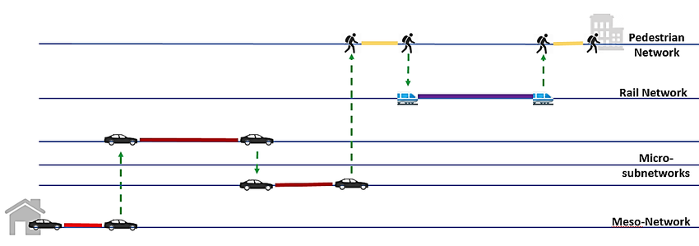
Bus transit
Combined with other APIs for multi-vehicle trip.

Slide 15
04 SAFETY FIRST

Slide 16
Safety
ALERT
EQUIPMENT
Users can report the accident cause and then exit.
Safety equipment such as Helmet.

